Slide 1
DATABASE PROJECT ON WHATS APP FEATURES
BY,
PRANATHI K.S
RANJAN
ASISH KUMAR
SAI PAVAN
DATTA SAI

Slide 2
SCHEMA DIAGRAM
PROFILE
------------------
PROFILE_ID
PROFILE_DP
ABOUT
PHONE_NO
NAME
STATUS1
------------------
STATUS_ID
PROFILE_ID
TIME
DATE
NAME
CHAT_ID
USER1
------------------
USER_ID
NAME
PHONE_NO
CONTACT_ID
CHAT_ID
PROFILE_ID
STATUS_ID
BROADCAST_ID
BROADCAST
-------------------
BROADCAST_ID
CHAT_ID
CONTACT_ID
CHATS
-----------------
CHAT_ID
NAME
PHONE_NO
TIME
DATE
BLOCK_ID
ONLINE
CONTACT1
----------------
CONTACT_ID
NAME
PHONE_NO
CHAT_ID
BLOCK_ID
BLOCKLIST
----------------
BLOCK_ID
NAME
PHONE_NO

Slide 3
ER - DIAGRAM
PROFILE_DP
PROFILE_ID
USER_ID
NAME
PHONE_NO
ABOUT
PROFILE
USER
BLOCK_ID
NAME
PHONE_NO
STATUS_ID
CONTACT_ID
CHAT_ID
PROFILE_ID
BROADCAST_ID
NAME
CHAT_ID
BLOCK_ID
CHAT_ID
BROADCAST
BR_MESSAGE
CONTACT_ID
PROFILE_DP
STATUS
CONTACT_ID
TIME
NAME
DATE
CONTACT
CONTACT_ID
CONTACT_ID
CHAT_ID
BLOCK_ID
CHATS
CONTACT_ID
PHONE_NO
CONTACT_ID
NAME
CONTACT_ID
BLOCK
BLOCK_ID
PHONE_NO

Slide 4
PRANATHI PART OF CODES

Slide 5
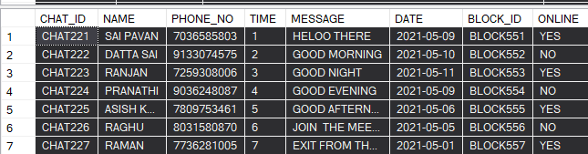
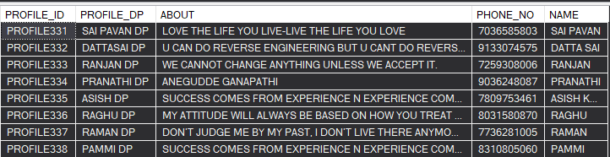
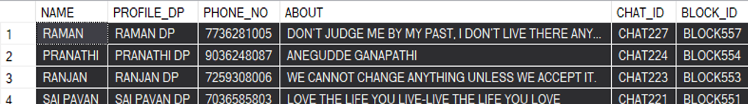
1.WRITE A QUERY TO DISPLAY NAME, PROFILE DP,PHONE NO ,ABOUT AND CHAT ID OF THE USER FROM CHATS AND PROFILE TABLE WHOSE NAME CONTAINS LETTER N AND CHAT ID MUST BE IN DESCENDING ORDER?
SELECT CHATS.NAME, PROFILE.PROFILE_DP, PROFILE.PHONE_NO, PROFILE.ABOUT, CHATS.CHAT_ID,CHATS.BLOCK_ID
FROM CHATS , PROFILE
WHERE CHATS.NAME=PROFILE.NAME AND CHATS.NAME LIKE '%N%'
ORDER BY CHATS.CHAT_ID DESC;
OUTPUT:

Slide 6
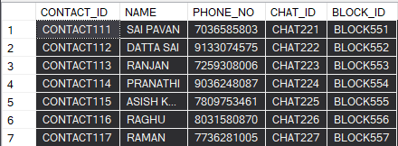
2.WRITE A QUERY TO DISPLAY CONTACT_ID,NANE,PHONE NO,TIME,DATE OF THE MESSAGE AND MESSAGES FROM CHAT AND CONTACT TABLE BUT THE USER MUST BE IN ONLINE AND MESSAGE STARTS WITH 'G'?
SELECT CONTACT1.CONTACT_ID, CONTACT1.NAME, CONTACT1.PHONE_NO, CHATS.TIME, CHATS.DATE,CHATS.MESSAGE,CHATS.ONLINE
FROM CONTACT1 INNER JOIN CHATS
ON CONTACT1.CHAT_ID =CHATS.CHAT_ID
WHERE ONLINE='YES' AND CHATS.MESSAGE LIKE 'G%';
OUTPUT:

Slide 7
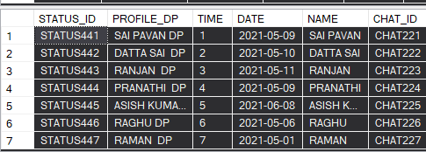
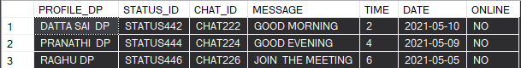
3.WRITE A QUERY TO DISPLAY PROFILE_DP,STATUS_ID,CHAT_ID,MESSAGES, MESSAGE TIME AND MESSAGE DATE OF WHO ARE IN OFFLINE USING USER AND CHATS TABLE WHERE MESSAGES CONTAINS 'O'?
SELECT STATUS1.PROFILE_DP, STATUS1.STATUS_ID, CHATS.CHAT_ID, CHATS.MESSAGE, CHATS.TIME, CHATS.DATE,CHATS.ONLINE
FROM STATUS1 INNER JOIN CHATS
ON STATUS1.NAME=CHATS.NAME
WHERE CHATS.ONLINE='NO' AND CHATS.MESSAGE LIKE '%O%';
OUTPUT:

Slide 8
4.WRITE A QUERY TO DISPLAY ABOUT,STATUS TIME,STATUS DATE, MESSAGES,CHAT DATE, CHAT TIME,WHO KEPT STATUS IN MAY MONTH AND USER MUST BE IN ONLINE?
SELECT PROFILE.ABOUT, STATUS1.TIME, CHATS.MESSAGE, CHATS.DATE, CHATS.TIME, CHATS.ONLINE
FROM PROFILE INNER JOIN STATUS1
ON PROFILE.PROFILE_DP=STATUS1.PROFILE_DP
INNER JOIN CHATS ON STATUS1.CHAT_ID=CHATS.CHAT_ID
WHERE STATUS1.DATE BETWEEN '2021-04-30' AND '2021-06-01' AND CHATS.ONLINE='YES';
OUTPUT:

Slide 9
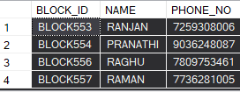
5.WRITE A QUERY TO DISPLAY CHAT_ID, MESSAGES,PROFILE_DP,PROFILE_ID,BLOCK_ID, NAME ABOUT OF WHO ARE IN ONLINE USING CHATS,PROFILE AND BLOCK LIST TABLE WHERE NAME STARTS WITH 'R' AND ENDS WITH 'N' AND CHAT_ID RANGE FROM 222 TO 227?
SELECT CHATS.CHAT_ID, CHATS.MESSAGE, PROFILE.PROFILE_DP, PROFILE.PROFILE_ID, BLOCKLIST.BLOCK_ID,CHATS.NAME,PROFILE.ABOUT
FROM CHATS INNER JOIN PROFILE ON CHATS.PHONE_NO=PROFILE.PHONE_NO
INNER JOIN BLOCKLIST ON PROFILE.PHONE_NO=BLOCKLIST.PHONE_NO
WHERE ONLINE='YES' AND CHATS.NAME LIKE 'R%N' AND CHATS.CHAT_ID BETWEEN 'CHAT222' AND 'CHAT227';
OUTPUT:

Slide 10
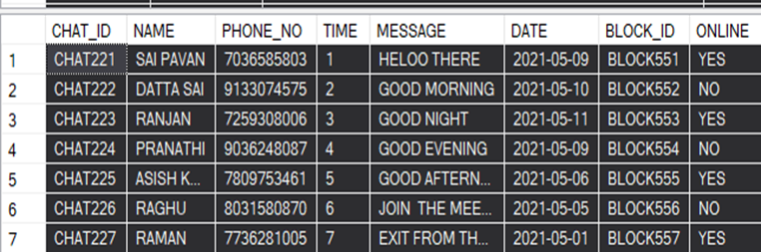
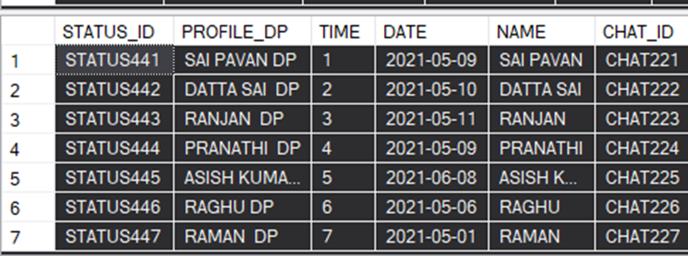
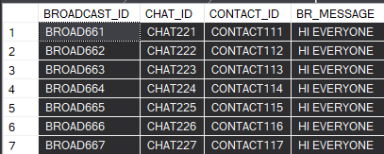
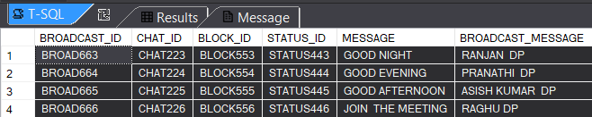
6.WRITE A QUERY TO DISPLAY BROADCAST_ID,CHAT_ID, BLOCK_ID,STATUS_ID
MESSAGES,PROFILE_DP,NAME, BROADCAST_MESSAGE USING BROADCAST,CHAT AND STATUS TABLE WHERE THE BROADCAST_ID RANGE FROM 663 TO 666 AND NAME CONTAINS 'A'?
SELECT BROADCAST.BROADCAST_ID, CHATS.CHAT_ID, CHATS.BLOCK_ID, STATUS1.STATUS_ID, CHATS.MESSAGE, STATUS1.PROFILE_DP
BROADCAST_MESSAGE
FROM BROADCAST INNER JOIN CHATS ON BROADCAST.CHAT_ID=CHATS.CHAT_ID
INNER JOIN STATUS1 ON STATUS1.CHAT_ID=CHATS.CHAT_ID
WHERE BROADCAST_ID BETWEEN 'BROAD663' AND 'BROAD666' AND CHATS.NAME LIKE '%A%';
OUTPUT:

Slide 11
RANJAN PART OF CODES

Slide 12
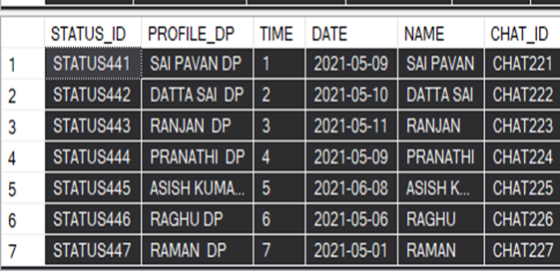
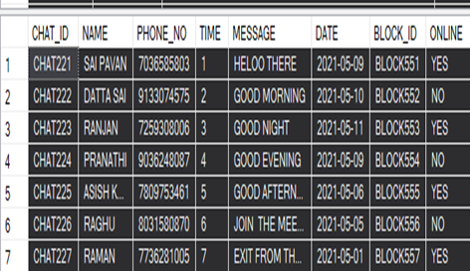
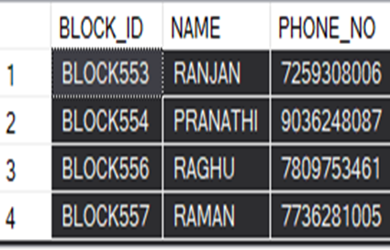
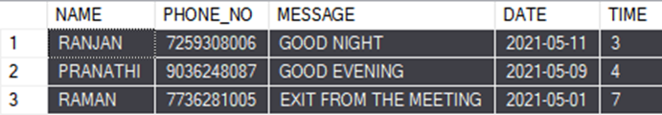
1. WRITE A QUERY A DISPLAY NAME , PHONE_NO , MESSAGE , DATE AND TIME OF THE USER FROM STATUS1 TABLE , CHATS TABLE AND BLOCK TABLE IN WHICH NAME SHOULD NOT CONSIST N LETTER EITHER IN FIRST OR IN LAST LETTER AND ORDERED BY STAUTS_ID?
SELECTSTATUS1.NAME,CHATS.PHONE_NO,CHATS.MESSAGE,STATUS1.DATE,STATUS1.TIME
FROM STATUS1 INNER JOIN CHATS ON STATUS1.CHAT_ID = CHATS.CHAT_ID
INNER JOIN BLOCKLIST ON CHATS.BLOCK_ID = BLOCKLIST.BLOCK_ID
WHERE STATUS1.NAME LIKE ('%N%')
ORDER BY STATUS1.STATUS_ID ;
OUTPUT:

Slide 13
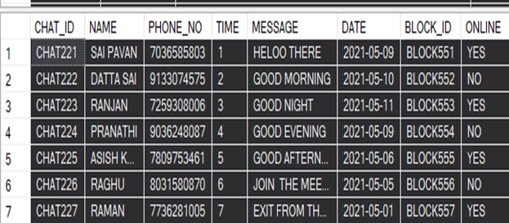
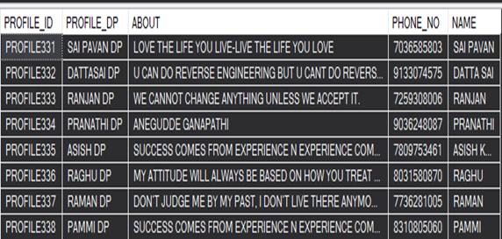
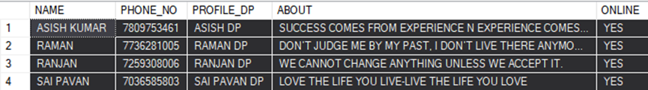
2. WRITE A QUERY A DISPLAY NAME , PHONE_NO , PROFILE_DP , ABOUT ,
ONLINE OF THE USER USING CHATS TABLE AND PROFILE TABLE ONLY THOSE
WHO ARE ONLINE
SELECT CHATS.NAME,CHATS.PHONE_NO,PROFILE.PROFILE_DP,PROFILE.ABOUT,
CHATS.ONLINE
FROM CHATS LEFT JOIN PROFILE ON CHATS.NAME = PROFILE.NAME
WHERE CHATS.ONLINE = 'YES'
ORDER BY CHATS.NAME;
OUTPUT:

Slide 14
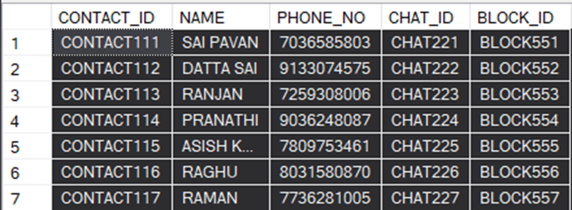
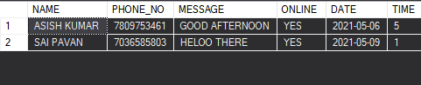
3. WRITE A QUERY TO DISPLAY THE NAME , PHONE_NO , MESSAGE ,ONLINE ,DATE AND TIME OF THE USER BY USING CONTACT1 , BLOCKLIST AND CHATS TABLE I N WHICH THE USER IS NOT BLOCKED AND USER IS IN ONLINE
SELECT CONTACT1.NAME,CONTACT1.PHONE_NO,CHATS.MESSAGE,CHATS.ONLINE,CHATS.DATE,
CHATS.TIME
FROM CONTACT1 LEFT JOIN BLOCKLIST ON BLOCKLIST.BLOCK_ID = CONTACT1.BLOCK_ID
INNER JOIN CHATS ON CONTACT1.CHAT_ID = CHATS.CHAT_ID
WHERE CONTACT1.NAME NOT IN ('RANJAN','PRANATHI','RAGHU','RAMAN')
AND CHATS.ONLINE='YES'
ORDER BY CONTACT1.NAME;
OUTPUT:

Slide 15

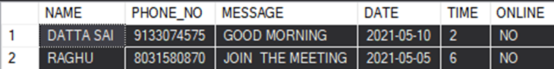
4. WRITE A QUERY A DISPLAY NAME , PHONE_NO , MESSAGE , DATE AND TIME
AND ONLINE OF THE USER USING CONTACT TABLE AND CHATS TABLE WHERE
THE USER SHOULD BE OFFLINE AND CHAT TIME SHOULD BE NOT IN 4
SELECT CHATS.NAME ,CHATS.PHONE_NO , CHATS.MESSAGE , CHATS.DATE ,CHATS.TIME,CHATS.ONLINE
FROM CONTACT1 INNER JOIN CHATS ON CONTACT1.CHAT_ID = CHATS.CHAT_ID
WHERE CHATS.ONLINE='NO' AND CHATS.TIME NOT IN (4);
OUTPUT:

Slide 16
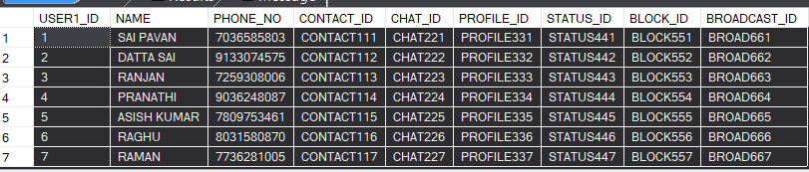
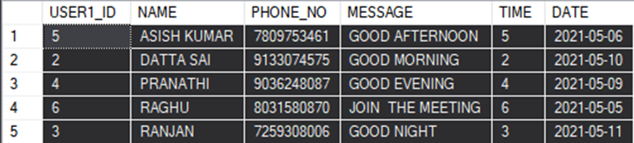
5. WRITE A QUERY A DISPLAY THE USER _ID,NAME , PHONE_NO , MESSAGE , DATE AND TIME OF THE USER BY USING CHAT TABLE AND USER1 TABLE WHOSE CHAT TIME IS BETWEEN 2 AND 6 AND THE USER_ID SHOULD BE ARRANGED IN DESCENDING ORDER
SELECT USER1.USER1_ID ,USER1.NAME,USER1.PHONE_NO, CHATS.MESSAGE,CHATS.TIME,CHATS.DATE
FROM USER1 INNER JOIN CHATS ON USER1.CHAT_ID = CHATS.CHAT_ID
WHERE CHATS.TIME BETWEEN 2 AND 6
ORDER BY USER1.NAME;
OUTPUT:

Slide 17
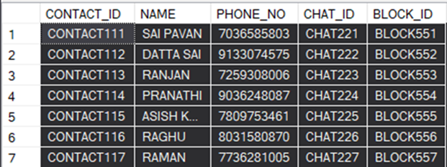
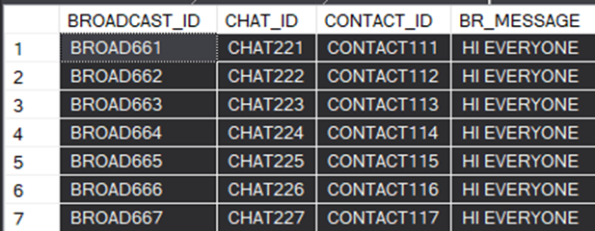
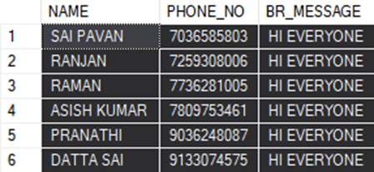
6.WRITE A QUERY A DISPLAY THE NAME , PHONE_NO , BR_MESSAGE OF THE USER USING CONTACT TABLE AND BROADCAST TABLE IN WHICH NAME CONSIST OF TWO A’s AND ORDERED BY PHONE_NO
SELECT CONTACT1.NAME, CONTACT1.PHONE_NO, BROADCAST.BR_MESSAGE
FROM CONTACT1 INNER JOIN BROADCAST ON CONTACT1.CONTACT_ID = BROADCAST.CONTACT_ID
WHERE CONTACT1.NAME LIKE ('%A%A%')
ORDER BY CONTACT1.PHONE_NO;
OUTPUT:

Slide 18
ASISH PART OF CODES

Slide 19
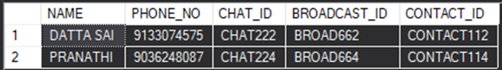
1. WRITE A QUARRY TO DISPLAY CONTACT NAME,PHONE NUMBER,CHAT_ID,BROADCAST_ID,
CONTACT_ID FROM CONTACT TABLE AND JOIN WITH BROADCAST TABLE AND FIND OUT WHOSE NAME ENDS WITH ‘ I ‘ AND ORDER WISE ACSENDNG TO DESCENDING BY THEIR NAME.
SELECTCONTACT1.NAME,CONTACT1.PHONE_NO,CONTACT1.CHAT_ID,
BROADCAST.BROADCAST_ID,BROADCAST.CONTACT_ID
FROM CONTACT1
INNER JOIN BROADCAST ON CONTACT1.CONTACT_ID =
BROADCAST.CONTACT_ID
WHERE NAME LIKE '%I'
ORDER BY CONTACT1.NAME;
OUTPUT:

Slide 20
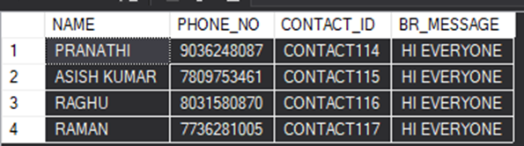
2. WRITE A QUARRY TO DISPLAY CONTACT NAME,CONTACT PHONE NO,BROADCAST ID,BROADCAST MESSAGE FROM JOINING THE TABLES AND FIND OUT IN TABLE THOSE LAST 4 NAMES AND NUMBERS FROM BROADCAST TABLE.
SELECT CONTACT1.NAME,CONTACT1.PHONE_NO,BROADCAST.CONTACT_ID,BROADCAST.BR_MESSAGE
FROM CONTACT1
INNER JOIN BROADCAST ON BROADCAST.CONTACT_ID = CONTACT1.CONTACT_ID
WHERE
BROADCAST.CONTACT_ID = CONTACT1.CONTACT_ID AND CONTACT1.CONTACT_ID IN('CONTACT114','CONTACT115','CONTACT116','CONTACT117');
OUTPUT:

Slide 21
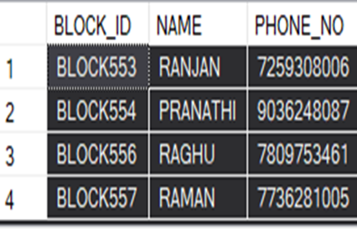
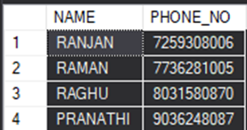
3. WRITE A QUARRY TO DISPLAY CONTACT NAME , CONTACT PHONE NO AND FIND OUT BLOCKED LIST FROM TABLE USIN ORDER BY NAMES.
SELECT CONTACT1.NAME,CONTACT1.PHONE_NO
FROM CONTACT1
INNER JOIN BLOCKLIST ON CONTACT1.BLOCK_ID = BLOCKLIST.BLOCK_ID
ORDER BY CONTACT1.NAME DESC;
OUTPUT:

Slide 22
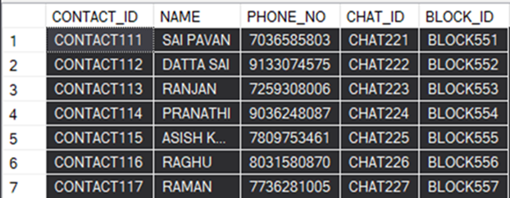

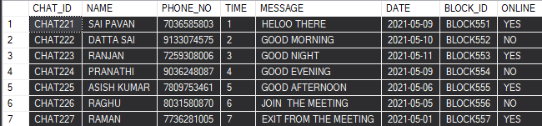
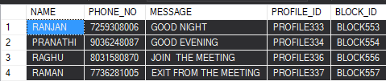
4.WRITE A QUARRY TODISPLAY NAME,PHONE_NO,CHATS.MEAGE,PROFILE_ID,BLOCK_ID ATRIBUTE AND JOIN 4 TABLES (USER TABLE,CONTACT TABLE,CHAT TABLE,BLOCK TABLE) FOR GETTING THOSE DATA.
SELECT CONTACT1.NAME,CONTACT1.PHONE_NO,CHATS.MESSAGE,USER1.PROFILE_ID,
BLOCKLIST.BLOCK_ID
FROM CONTACT1 JOIN CHATS ON CONTACT1.CHAT_ID=CHATS.CHAT_ID
JOIN BLOCKLIST ON CHATS.BLOCK_ID=BLOCKLIST.BLOCK_ID
JOIN USER1 ON USER1.BLOCK_ID=BLOCKLIST.BLOCK_ID;
OUTPUT:

Slide 23
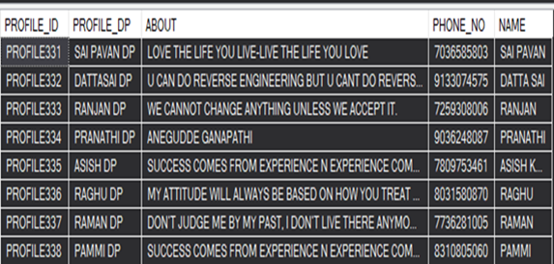
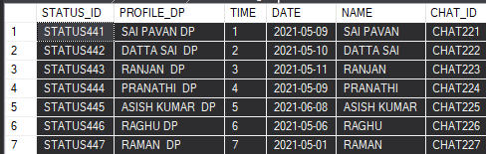
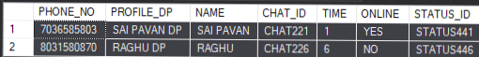
5. WRITE A QUARRY TO DISPLAY PHONE_NO,PROFILE_DP,NAME,CHAT_ID,TIME,ONLINE OR OFFLINE ,STATUS_ID USING JOINS ALL TABLE AND FIND OUT WHOSE PROFILE_DP IS MATCHED.
SELECT PROFILE.PHONE_NO,PROFILE.PROFILE_DP,PROFILE.NAME,
CHATS.CHAT_ID,CHATS.TIME,CHATS.ONLINE,STATUS1.STATUS_ID
FROM PROFILE JOIN STATUS1 ON PROFILE.PROFILE_DP=STATUS1.PROFILE_DP
JOIN CHATS ON STATUS1.CHAT_ID=CHATS.CHAT_ID;
OUTPUT:

Slide 24
SAIPAVAN PART OF CODES

Slide 25
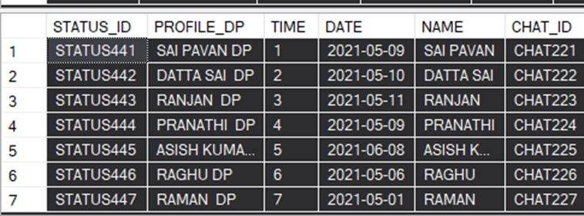
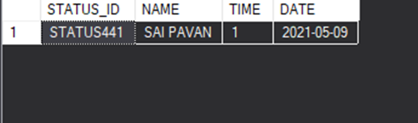
1.WRITE A QUERY TO GET PARTICULAR STATUS DATA USING LIKE OPERATOR AND JOINS(WHEN WE KEPT THAT STATUS AND DATA NAME LIKE 'S%N'). IT DISPLAYS STATUS_ID,NAME,TIME AND DATE.
SELECT STATUS1.STATUS_ID,STATUS1.NAME,STATUS1.TIME,STATUS1.DATE FROM STATUS1 INNER JOIN PROFILE ON STATUS1.PROFILE_DP = PROFILE.PROFILE_DP WHERE STATUS1.NAME LIKE 'S%N';
OUTPUT:

Slide 26
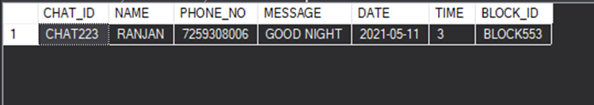
2. WRITE A QUERY TO DISPLAY THE BLOCK-LIST PERSON LAST MESSAGES WITH DATE AND TIME. USING JOINS WITH ORDER BY IN ASCENDING ORDER.IT DISPLAYS CHAT_ID,NAME,PHONE_NO,MESSAGE,DATE,TIME AND BLOCK_ID.
SELECT TOP 1 CHATS.CHAT_ID,CHATS.NAME,CHATS.PHONE_NO,CHATS.MESSAGE,
CHATS.DATE,CHATS.TIME,CHATS.BLOCK_ID
FROM CHATS INNER JOIN BLOCKLIST ON CHATS.BLOCK_ID = BLOCKLIST.BLOCK_ID
ORDER BY CHATS.DATE DESC;
OUTPUT:

Slide 27
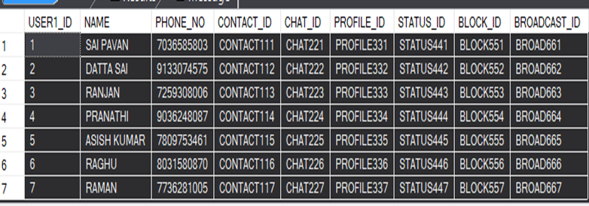
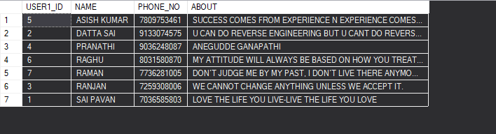
3. WRITE A QUERY TO GET ALL USERS IN HIS PROFILE THAT WILL SHOW.USING INNER JOINS AND ORDER BY IN ASC. IT DISPLAYS USER_ID,NAME,PHONE_NO AND ABOUT.
SELECT USER1.USER1_ID,USER1.NAME,USER1.PHONE_NO,ABOUT
FROM USER1 INNER JOIN PROFILE ON USER1.PROFILE_ID = PROFILE.PROFILE_ID ORDER BY USER1.NAME;
OUTPUT:

Slide 28
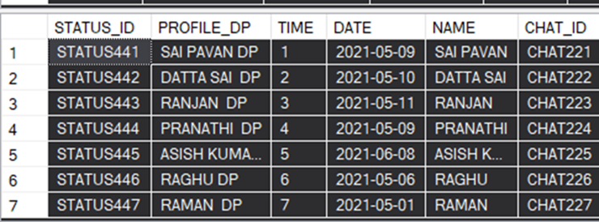
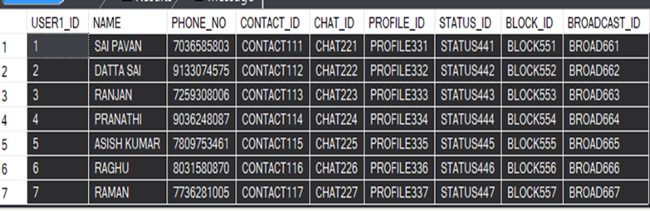
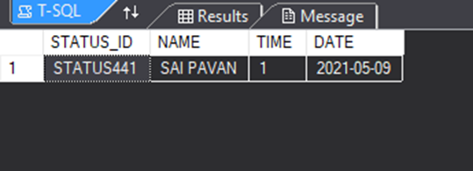
4.WRITE A QUERY TO GET PARTICULAR USER STATUS DATA USE OF PARTICULAR DATE AND TIME.USING JOINS WITH AND CONDITION. IT DISPLAYS STATUS_ID,NAME,TIME AND DATE.
SELECT STATUS1.STATUS_ID,STATUS1.NAME,STATUS1.TIME,STATUS1.DATE
FROM USER1 INNER JOIN STATUS1 ON USER1.STATUS_ID = STATUS1.STATUS_ID
where STATUS1.DATE='2021-05-09' AND STATUS1.TIME='1';
OUTPUT:

Slide 29
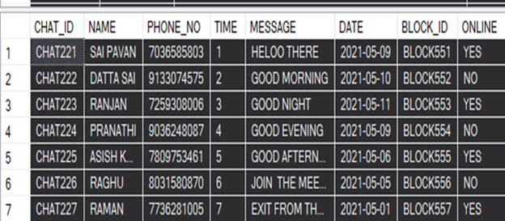

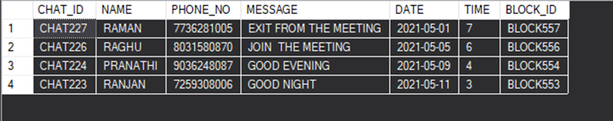
5. WRITE A QUERY TO GET WHOEVER IN CHATS AND WHOEVER IN BLOCK.IT DISPLAYS COMMON MEMBERS FROM BOTH CHATS TABLE AND BLOCK TABLE.FINALLY WE GET WHOEVER CHATTED PEOPLE IN BLOCK TABLE. USING JOINS AND DESC KEYWORD.IT DISPLAYS CHAT_ID,NAME,PHONE_NO,MESSAGE,DATE,TIME AND BLOCK_ID.
SELECT CHATS.CHAT_ID,CHATS.NAME,CHATS.PHONE_NO,CHATS.MESSAGE,
CHATS.DATE,CHATS.TIME,CHATS.BLOCK_ID
FROM CHATS INNER JOIN BLOCKLIST ON CHATS.BLOCK_ID = BLOCKLIST.BLOCK_ID
ORDER BY CHATS.BLOCK_ID DESC;
OUTPUT:

Slide 30
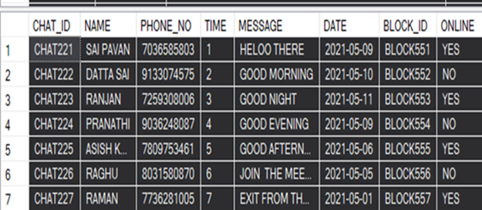
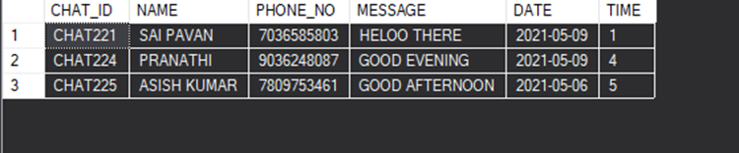
6. WRITE A QUERY TO GET WHOEVER SENT MESSAGES ON A PARTICULAR DATES .USING JOINS AND BETWEEN OPERATOR .IT DISPLAYS CHAT_ID,NAME,PHONE_NO,MESSAGE,DATE AND TIME.
SELECT CHATS.CHAT_ID,CHATS.NAME,CHATS.PHONE_NO,CHATS.MESSAGE,
CHATS.DATE,CHATS.TIME
FROM USER1 INNER JOIN CHATS ON CHATS.CHAT_ID = USER1.CHAT_ID
WHERE CHATS.DATE BETWEEN '2021-05-06' AND '2021-05-09';
OUTPUT:

Slide 31
DATTASAI PART OF CODES

Slide 32
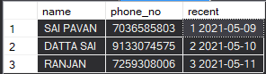
1. WRITE A QUERY TO DISPLAY TOP 3 RECENT CONTACTED PERSONS
SELECT TOP 3 U.NAME, U.PHONE_NO, CONCAT(C.TIME,' ',C.DATE) AS RECENT
FROM USER1 U, CHATS C
WHERE U.CHAT_ID=C.CHAT_ID ORDER BY RECENT;
OUTPUT:

Slide 33
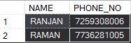
2. WRITE A QUERY TO DISPLAY BLOCK LIST NUMBERS WHOSE NAME ENDS WITH N
SELECT C.NAME, C.PHONE_NO FROM BLOCKLIST B, CONTACT1 C
WHERE C.BLOCK_ID=B.BLOCK_ID AND C.NAME LIKE '%N';
OUTPUT:

Slide 34

3. WRITE A QUERY TO DISPLAY THE STATUS TIME USING OUTER JOIN
SELECT S.PROFILE_DP AS "NAME",P.ABOUT AS "ABOUT NEW", U.BROADCAST_ID AS "EVERYONE", S.TIME AS "STATUS TIME"
FROM STATUS1 S,PROFILE P,USER1 U FULL OUTER JOIN CHATS C ON C.PHONE_NO=U.PHONE_NO
WHERE C.CHAT_ID=S.CHAT_ID AND P.PHONE_NO=U.PHONE_NO;
OUTPUT:

Slide 35

4. WRITE A QUERY TO DISPLAY THE DATA OF THE NUMBER STARTS WITH 7 AND WHOSE IN STATUS IN ONLINE
SELECT U.NAME, P.PROFILE_DP,C.PHONE_NO, C.MESSAGE
FROM USER1 U, PROFILE P, CHATS C
WHERE U.PHONE_NO=P.PHONE_NO AND C.PHONE_NO=P.PHONE_NO AND C.ONLINE='YES' AND C.PHONE_NO LIKE '7%';
OUTPUT:

Slide 36

5. QUERY TO DISPLAY NAME, PROFILE DP,PHONE NO ,ABOUT AND CHAT ID OF THE USER FROM CHATS AND PROFILE TABLE WHOSE NAME CONTAINS LETTER I AND CHAT ID
SELECT CHATS.NAME, PROFILE.PROFILE_DP, PROFILE.PHONE_NO, PROFILE.ABOUT, CHATS.CHAT_ID,CHATS.BLOCK_ID
FROM CHATS , PROFILE
WHERE CHATS.NAME=PROFILE.NAME AND CHATS.NAME LIKE '%I%'
ORDER BY CHATS.CHAT_ID ;
OUTPUT:

Slide 37
THANK YOU

